Slide 1

Predicting Store Sales for Efficient Workforce Scheduling
Team 5
Low Wei Rong
Chin
Chong Yan
Shaun Lim

Slide 2
Presentation Outline
Business Objectives
Data Preparation
Feature Creation
Modelling & Evaluation
Key Insights & Suggestions
Conclusion

Slide 3

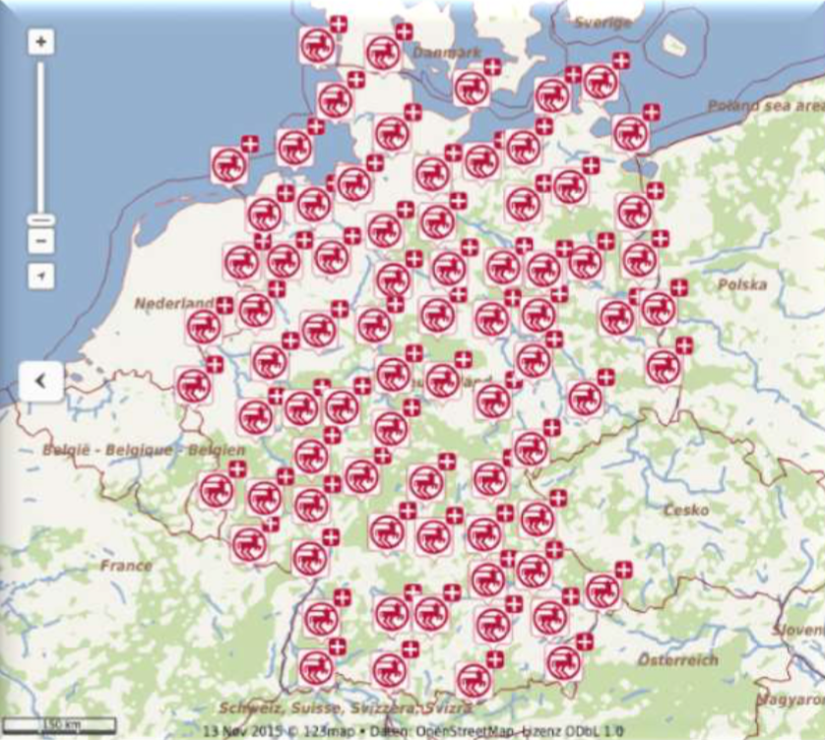
1. Introduction to Rossman Stores
46
Years in the business
2nd
Largest Drug Store Chain in Germany
3000
Stores in 7
Countries

Slide 4



1. Workforce Planning in Rossman
“Workforce Planning is the continuous process of aligning the needs and priorities of the business with those of its workforce, in order to meet the regulatory, legislative, service and production requirements.”
Proper workforce planning potential leads to 6.15% savings in lost sales and a 5.74% improvement in profitability
Workforce Planning Process
6 weeks sales forecast
Manager manually plans staffing schedule
Staff scheduled
Dependent on manager capability, leading to overstaffing or understaffing

Slide 5
1. Consequences of Improper Workforce Planning
Impact on | Understaffing | Overstaffing
Staff | Overworking of store associates, declining staff satisfaction Poor financial performance and higher attrition | Manpower costs represent 30-35% of total sales Financial waste with unnecessary staff Employee dissatisfaction when shifts are terminated due to lack of demand
Customers | Poor Service Level Affecting Reputation Diverting sales to competitors | Bored employees gives the impression of poor service to customers

Slide 6
Project Objective:
We aim to predict Rossmann store sales based on the available dataset, so as to enable Rossman store managers to produce effective staff schedules.

Slide 7
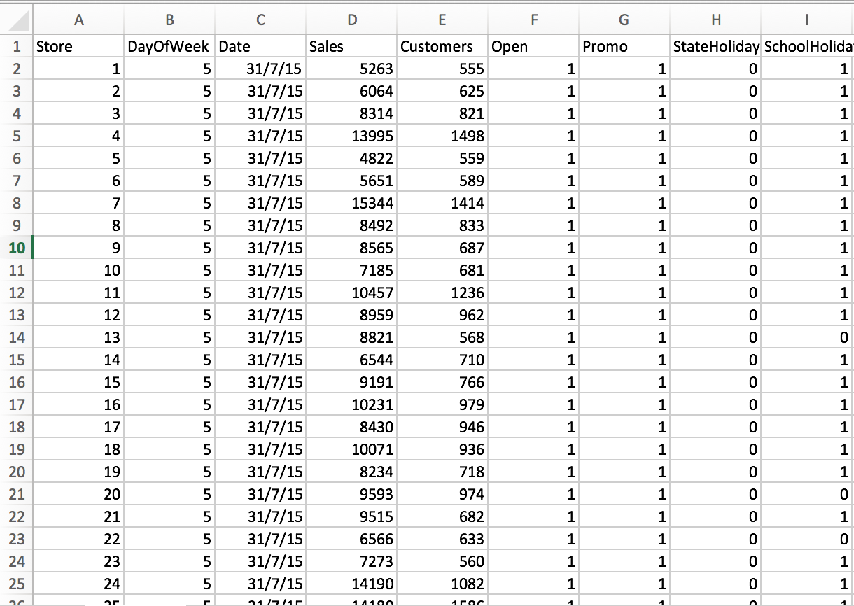
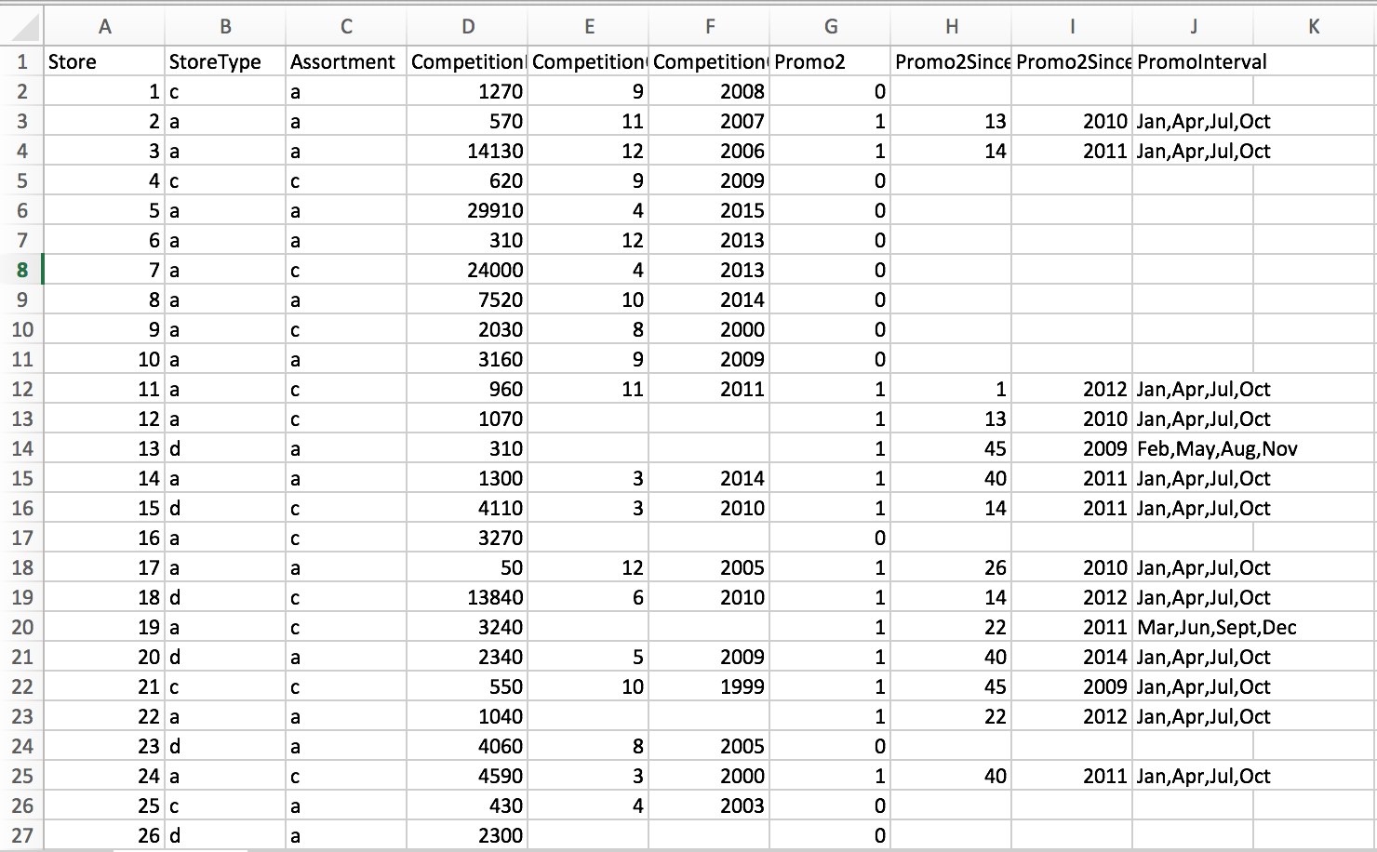
2. Data Preparation: Data Snapshot
Presentation Outline
Train.csv: contains sales related information at a store level on a daily basis, along with relevant demographic information
Store.csv: contains the information specific to each store

Slide 8
2. Data Preparation: Data Exploration
Data Field | Type | Description
Store | integer | a unique Id for each store
DayOfWeek | integer | day of the week
Date | character | date when the sale is made
Sales | integer | the turnover for any given day
Customers | integer | the number of customers on a given day
Open | integer | an indicator for whether the store was open: 0 = closed, 1 = open
StateHoliday | character | indicates a state holiday. Normally all stores, with few exceptions, are closed on state holidays. a = public holiday, b = Easter holiday, c = Christmas, 0 = None
SchoolHoliday | integer | indicates if the (Store, Date) was affected by the closure of public schools
StoreType | character | differentiates between 4 different store models: a, b, c, d
Assortment | character | describes an assortment level: a = basic, b = extra, c = extended
CompetitionDistance | integer | distance in meters to the nearest competitor store
Data Field | Type | Description
CompetitionOpenSince[Month/Year] | integer | gives the approximate year and month of the time the nearest competitor was opened
Promo | integer | indicates whether a store is running a promo on that day
Promo2 | integer | Promo2 is a continuing and consecutive promotion for some stores: 0 = store is not participating, 1 = store is participating
Promo2Since[Year/Week] | integer | describes the year and calendar week when the store started participating in Promo2
PromoInterval | character | describes the consecutive intervals Promo2 is started, naming the months the promotion is started anew.

Slide 9
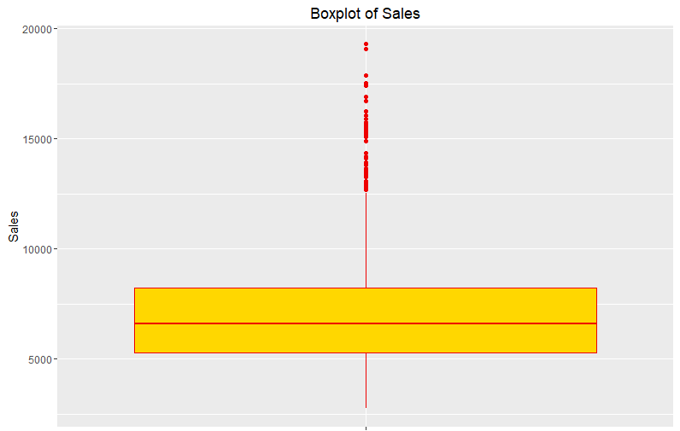
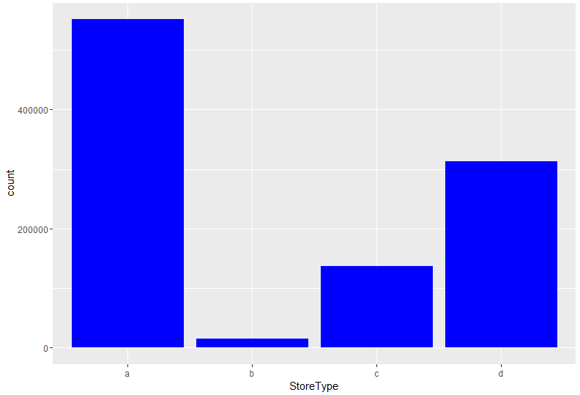
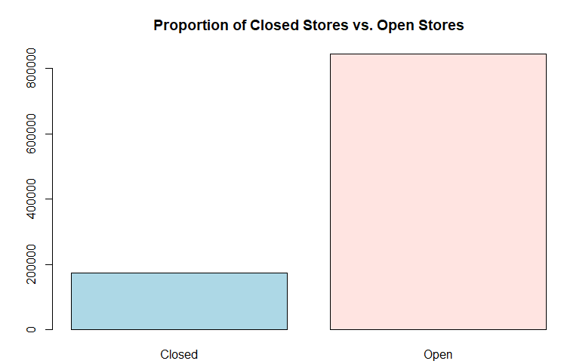
2. Data Preparation: Data Exploration
Store Type Distribution
Open vs Closed Stores
Sales Distribution
A>D>C>>B
Significant proportion of closed stores
No Negative Sales

Slide 10
2. Data Preparation: Data Cleaning
Train.csv
Store.csv
1. Merging Data Sets
2. Correcting Classes
3. Removing Closed Stores
Train.dt
4. Data Trimming

Slide 11
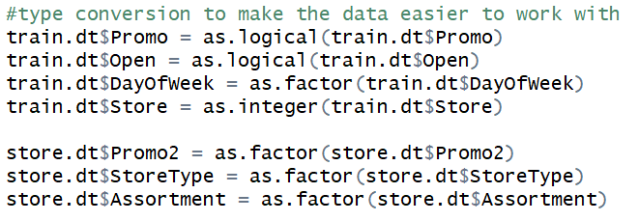
2. Data Preparation: Data Cleaning
1. Merging Data Sets
2. Correcting Classes
3. Removing Closed Stores
4. Data Trimming

Slide 12
2. Data Preparation: Data Cleaning
1. Merging Data Sets
2. Correcting Classes
3. Removing Closed Stores
4. Data Trimming

Slide 13
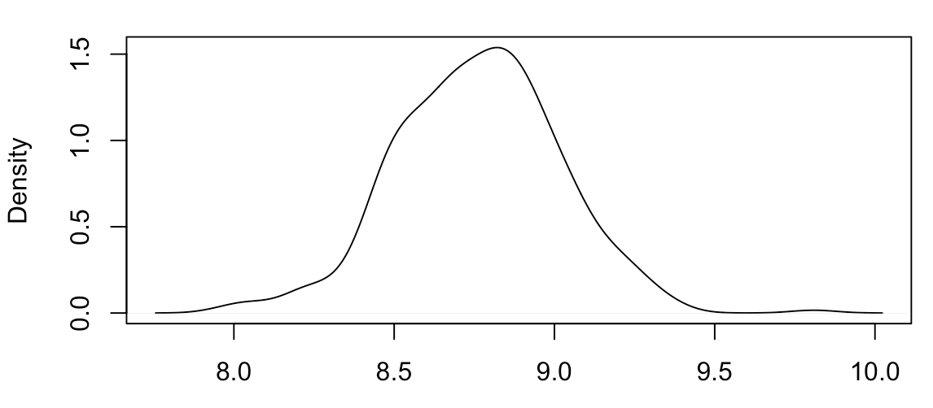
2. Data Preparation: Data Cleaning
1017209 Lines
1. Merging Data Sets
Pick only Store D
312912 Lines
2. Correcting Classes
Categorise sales into 12 percentiles
3. Removing Closed Stores
4. Data Trimming
Pick 12 stores
4500 Lines

Slide 14
2. Data Preparation: Train Test Split
2450 Train, 1050 Validate
1000
Train + Validate
Test
Time

Slide 15
3. Feature Creation
Information provided was insufficient to capture trends
We sought to create features that relate to past/future data
Presentation Outline
Number of days since last promotion
Day & Month of the year
Closed yesterday?
School Holiday tomorrow?
Weekend tomorrow?
Weekend yesterday?
Category

Slide 16
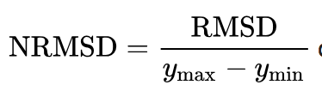
4. Modelling & Evaluation
1
2
3
4
Linear Regression Model
CART
Random
Forest
XGBoost
Evaluation Criteria:
In the industry, Normalised Root Mean Square Error (NRMSE) is the classic statistical error to measure forecast errors.

Slide 17
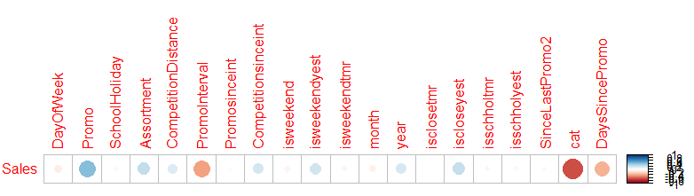
4.1 Linear Regression: Correlation
Feature Selection
Model Building
Key Results
Parameters Used:
Promo
PromoInterval
Cat
DaysSincePromo
Set | NRMSE
Train | 0.0802
Test | 0.1318

Slide 18

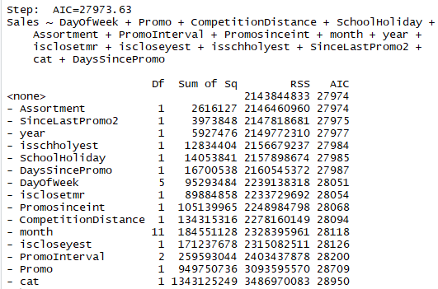
4.1 Linear Regression: Stepwise AIC
Feature Selection
Model Building
Key Results
Parameters Used:
DayOfWeek
Promo
PromoInterval
SchoolHoliday
Assortment
Promosinceint
Iscloseyest
Isclosetmr
Isschholyest
SinceLastPromo2
Competition Distance
Cat
DaysSincePromo
Set | NRMSE
Train | 0.0741
Test | 0.1123

Slide 19
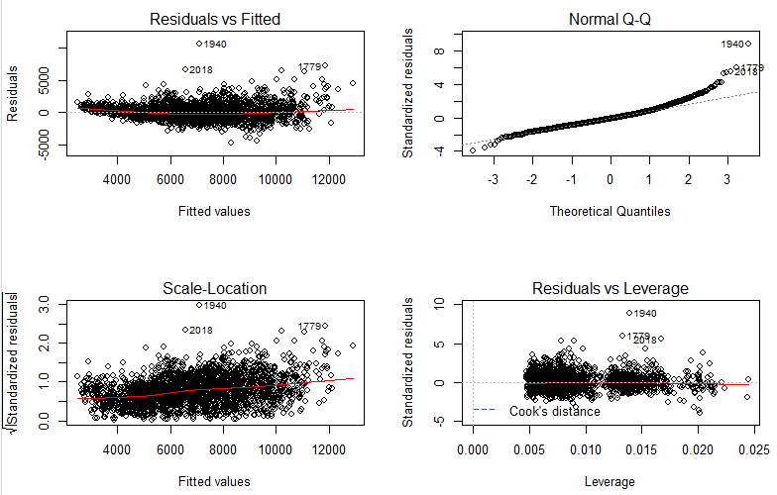
4.1 Linear Regression: Evaluation

Slide 20
4.2 CART: Introduction
Uses Decision Tree to split dataset along features. Accepts 2 parameters:
Complexity parameter
Depth
4 steps used to generate trees:
1. Rpart with default specifications; no input parameters, used as base model for comparison.
2. Set CP to 0 and grow tree out to maximum, followed by pruning using CP with lowest xerror value.
3. Rpart with important parameters; variables selected from (1) based on importance, using varImp function.
4. Train rpart based on depth using caret. No further adjustments for CP needed.

Slide 21
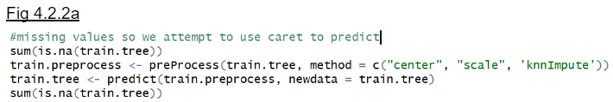
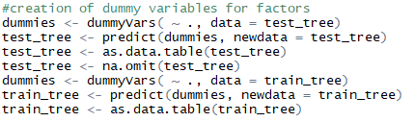
4.2 CART: Pre-processing of data
Normalising data
K nearest neighbor imputation
Assign negative weights to missing values in some columns

Slide 22
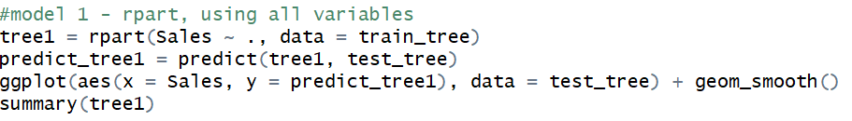
4.2 CART: Progression
Step 1 (Base model):
Xerror | Splits | NRMSE
0.2715 | 11 | 0.1871
Step 2 (Important variables):
Xerror | Splits | NRMSE
0.2646 | 10 | 0.1338*
*Un-tuned model, variables strongly correlated.
Step 3 (Pruning):
Xerror | Splits | NRMSE
0.1940 | 104 | 0.1630*
*Overfitted, performs badly on cross-validation!
Step 4 (caret):
Xerror | Splits | NRMSE
0.5198* | 104 | 0.1790
*Caret has different metric for cross-validation.

Slide 23
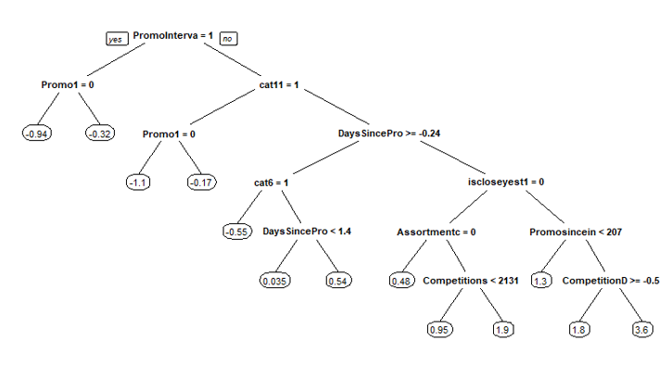
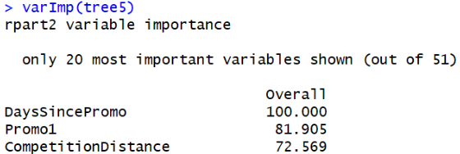
4.2 CART: Final Model
Xerror | Splits | NRMSE
0.5198* | 104 | 0.1790

Slide 24
4.3 Random Forest: Introduction
Combines collection of highly uncorrelated trees together, and in doing so:
Generates better prediction values
Reduces probability of overfitting
Tuning parameter: mtry
Reduces correlation between individual trees
1. Base RF, using every variable
2. RF with random parameter search (optimise mtry)
3. RF with gridsearch of 20 values, using k-folds cross-validation*
4. RF with tuneRF to select optimised mtry value
4 steps used to generate trees:
*Alternative to k-folds is out of bag testing. Usually results in lower RMSE, but running time much longer.

Slide 25
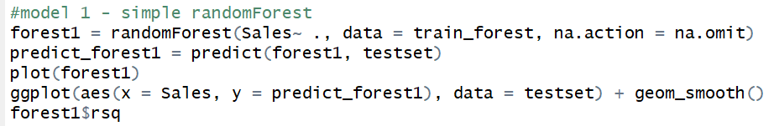
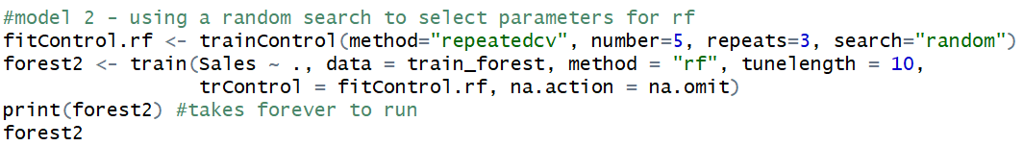
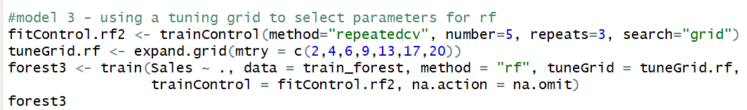
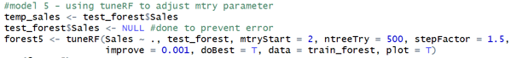
4.3 Random Forest: Progression
Step 1 (base model):
R-squared | mtry | NRMSE
0.8639 | 6 | 0.1298
Step 2 (random search):
R-squared | mtry | NRMSE
0.8592 | 20 | 0.1478*
*Randoming mtry inefficient for small dataset.
Step 3 (gridsearch using k-folds):
R-squared | mtry | NRMSE
0.854 | 9 | 0.1452*
*Due to multiple cross-validation & selection of model.
Step 4 (tuneRF):
R-squared | mtry | NRMSE
0.8624 | 6 | 0.1298*
*Performs much better on out-of-bag errors than base.

Slide 26
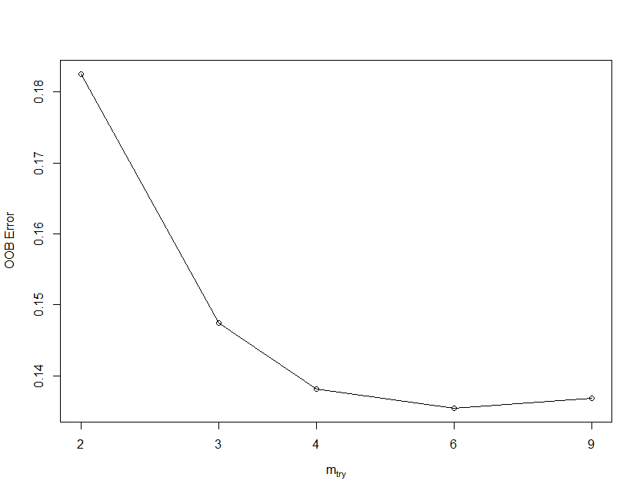
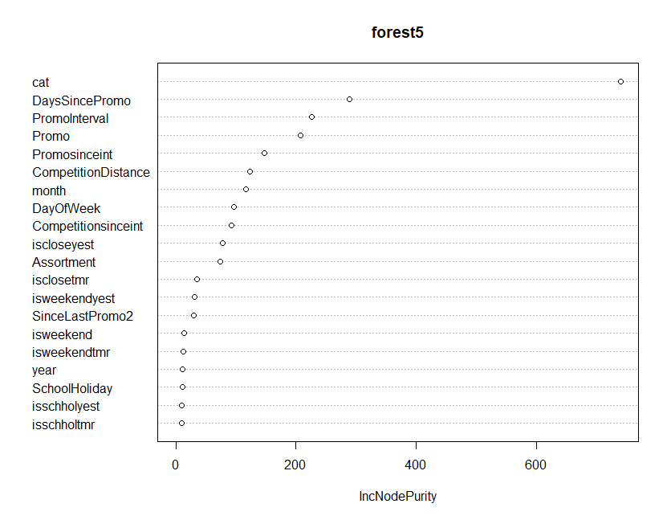
4.3 Random Forest: Final Model
R-squared | mtry | NRMSE
0.8624 | 6 | 0.1298

Slide 27
4.4 XgBoost
The weak learners are regression trees, and each regression tree maps an input data point to one of its leaves that contains a continuous score.
XGBoost minimizes a regularized (L1 and L2) objective function that combines a convex loss function (based on the difference between the predicted and target outputs) and a penalty term for model complexity.
The training proceeds iteratively, adding new trees that predict the residuals or errors of prior trees that are then combined with previous trees to make the final prediction.
It uses a gradient descent algorithm to minimize the loss when adding new models.

Slide 28
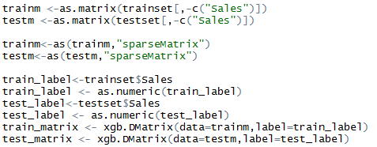
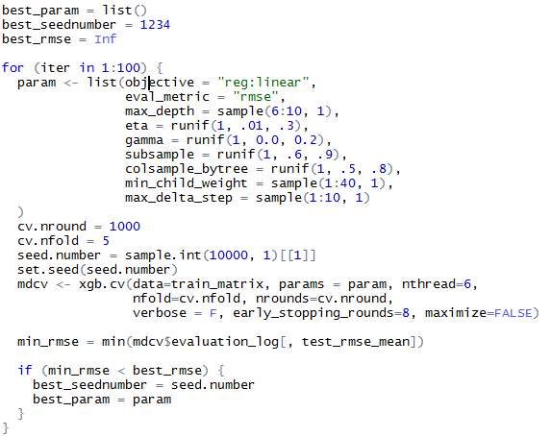
4.4 XGBoost
Data Preparation
Parameter Tuning
Optimal Parameter
Parameter | Optimal Values
max_depth | 10
eta | 0.2146533
gamma | 0.0282414
subsample | 0.8611443
colsample_bytree | 0.7506555
min_child_weight | 26
The model is built 100 times with random sampling of the various parameters to find the parameter combination which gives us the lowest cross validation error
Converted to xgb.Dmatrix for XgBoost to process
These parameters will be used in tuning the model

Slide 29
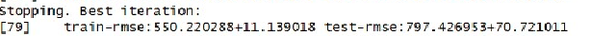
4.4 XGBoost
Optimal nrounds
Model Building
Results
Variable importance
(in decreasing order):
cat
CompetitionDistance
DaysSincePromo
Promo
DayOfWeek
month
iscloseyest
isclosetmr
SinceLastPromo2
year
The model is then run for 1000 iterations, and we obtain the best nrounds of 79
Set | NRMSE
Train | 0.0728
Test | 0.0848

Slide 30
5. Model Selection & Assembly: Result Summary
Algorithm | NRMSE (Train) | NRMSE (Test)
Linear Regression (AIC) | 0.07407643 | 0.1122801
CART | 0.07835757 | 0.1789976
Random Forest | 0.05208647 | 0.1298228
XGBoost | 0.07281979 | 0.08477629
High Errors + Overfit
High Errors + Overfit

Slide 31
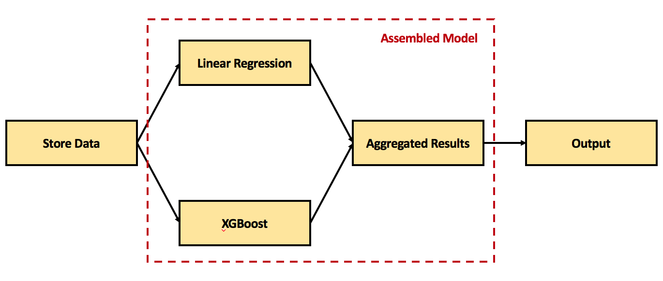
5. Model Selection & Assembly: Final Model

Slide 32
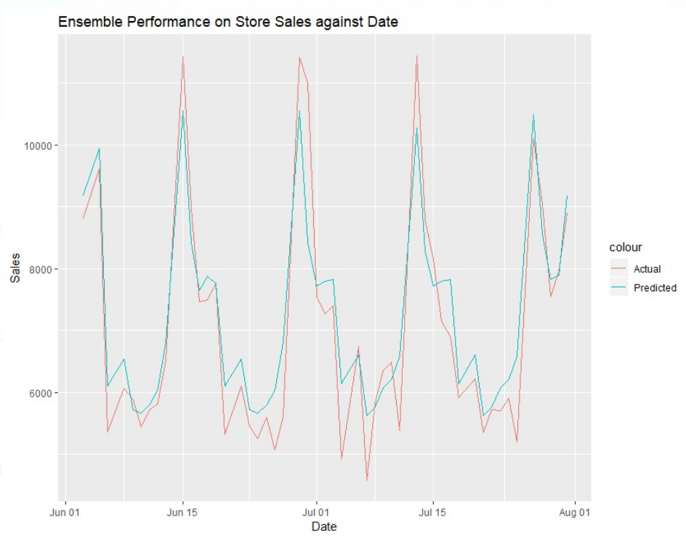
5. Model Selection & Assembly: Visualisation of Results

Slide 33
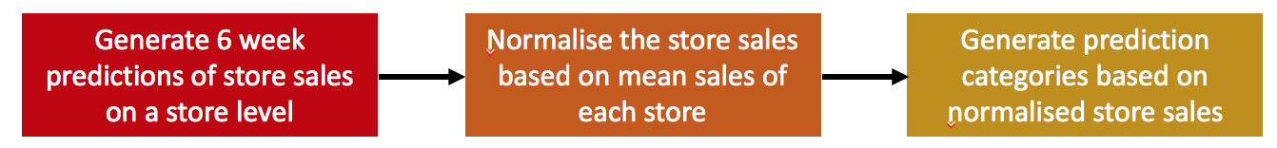
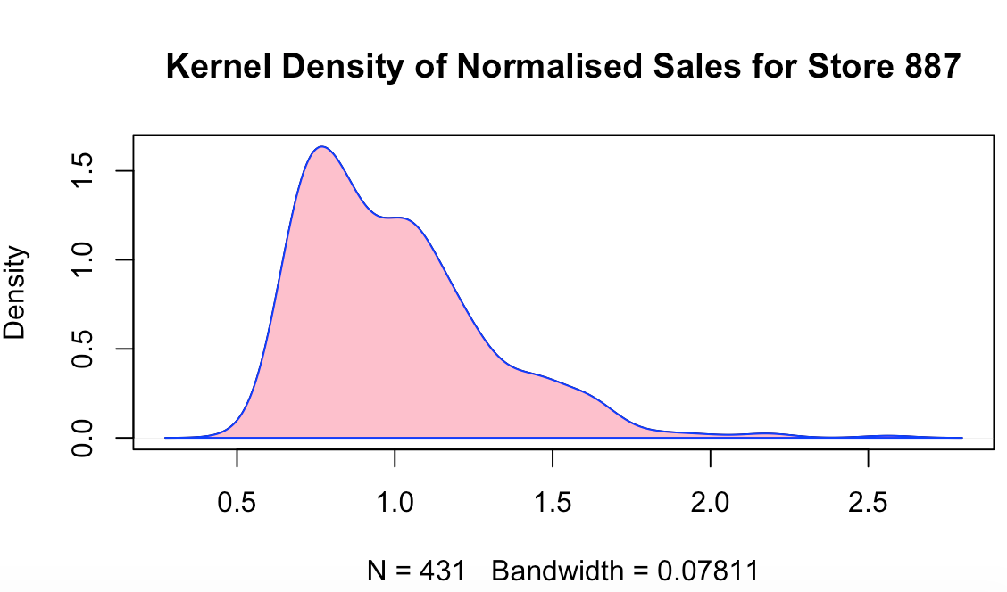
6. Insights & Solutions: Normalisation of Sales for Staff Scheduling
Sales Forecast Category | Normalised Sales for Store #887 Median: 6970, Min: 3534, Max: 17862 | Number of Workers Based on Store Manager’s Input
Very Light | <0.60 | 4
Light | 0.60 -- 0.80 | 6
Average | 0.80 -- 1.20 | 8
Heavy | 1.20 -- 1.40 | 10
Very Heavy | >1.40 | 12

Slide 34
6. Insights & Solutions: Automatic Scheduling
Automation is quickly replacing humans in logic-based tasks
Scorecard discussed previously can be input into a system to automatically generate manpower requirements
Manager only needs to fill in the name of the staff
Date | Sales Forecast | Manpower Required
12th November, Monday | Light | 6
13th November, Tuesday | Average | 8
14th November, Wednesday | Store Closed | -
15th November, Thursday | Heavy | 10
16th November, Friday | Average | 8

Slide 35
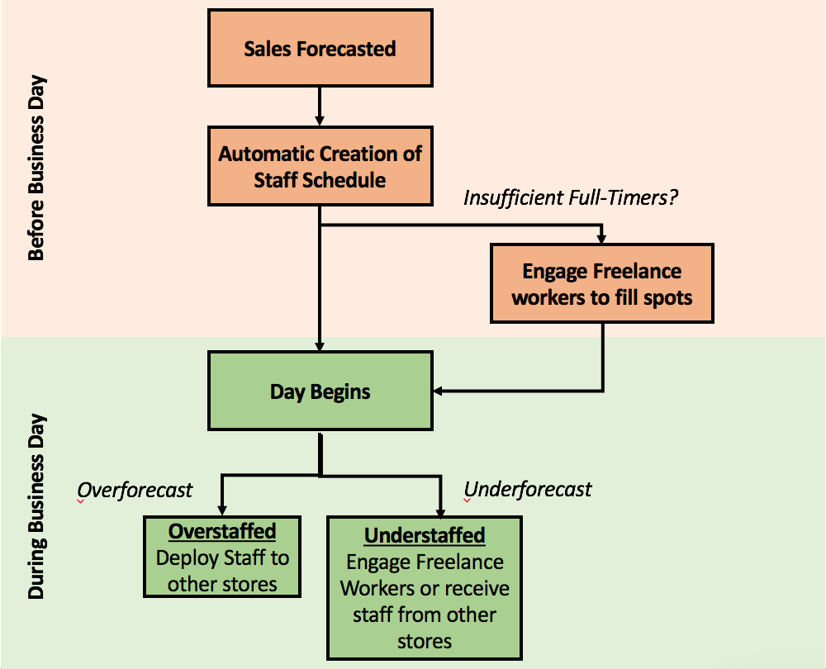
6. Insights & Solutions: Time Sharing of Workers
Based on sales forecast & staff schedule, further actions can be taken to ensure sufficient staffing between all stores

Slide 36
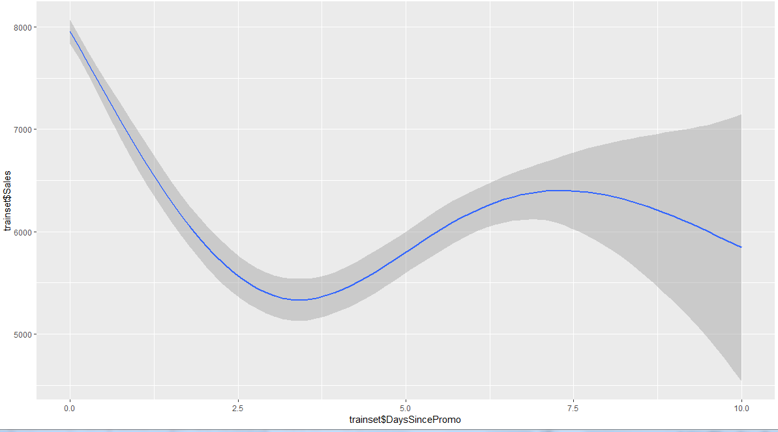
6. Insights & Solutions: Significant Variables
Algorithm | Linear Regression | CART | Random Forest | XGBoost
Significant Variables | 1. cat 2. Promo1 3. isclosetmr1 | 1. DaysSincePromo 2. Promo1 3. CompetitionDistance | 1. cat 2. DaysSincePromo 3. PromoInterval | 1. cat 2. DaysSincePromo 3. CompetitionDistance
Days Since Promotion
Sales fall sharply after promotion
Balance gain in revenue during promotion with the loss of revenue after promotion

Slide 37
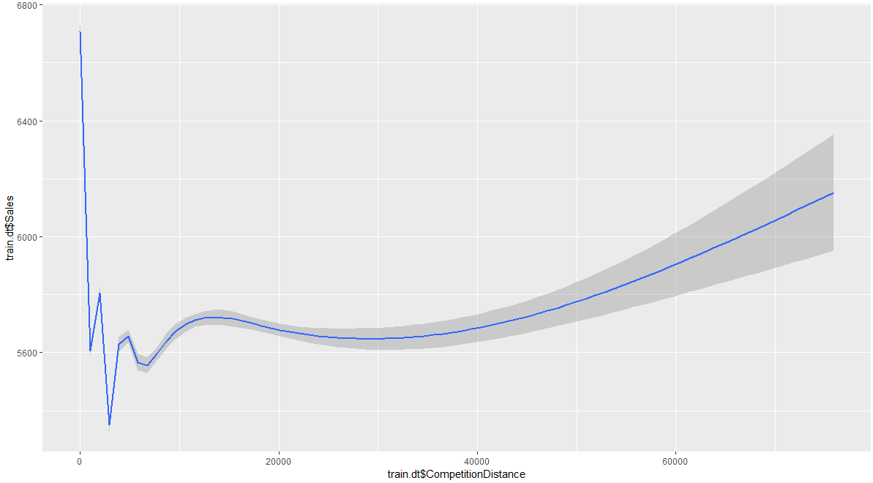
6. Insights & Solutions: Significant Variables
Algorithm | Linear Regression | CART | Random Forest | XGBoost
Significant Variables | 1. cat 2. Promo1 3. isclosetmr1 | 1. DaysSincePromo 2. Promo1 3. CompetitionDistance | 1. cat 2. DaysSincePromo 3. PromoInterval | 1. cat 2. DaysSincePromo 3. CompetitionDistance
Comp Distance
Higher Competition Distance, Higher Sales
Signifiy need to continue differentiating to stand out against competition

Slide 38
6. Insights & Solutions: Significant Variables
Algorithm | Linear Regression | CART | Random Forest | XGBoost
Significant Variables | 1. cat 2. Promo1 3. isclosetmr1 | 1. DaysSincePromo 2. Promo1 3. CompetitionDistance | 1. cat 2. DaysSincePromo 3. PromoInterval | 1. cat 2. DaysSincePromo 3. CompetitionDistance
Category
Initially classified as a measure of general store popularity
May not be sufficiently described by existing factors

Slide 39
6. Insights & Solutions: Study Limitations
Limited Data Points
Store Level Analysis
Expand to other Store Categories
Simple Model Assembly
Bootstrap Aggregating
Boosting
Categorical Y
Logistic Regression
Categorical Rpart
Limited Features
Geographical Features
Weather Features

Slide 40
7. Conclusion
Financial impacts of Understaffing & Overstaffing highlight’s urgency is getting Rossman’s staff scheduling problem right
Linear Regression, CART, RandomForest & XGBoost used to predict sales
Sales categorised and used to predict workforce requirements, with additional business insights generated from models
Context
Method
Solution

